Slide 1



377 Operating Systems
Join on Zoom if you are remote (see website for link).
Process API

Slide 2
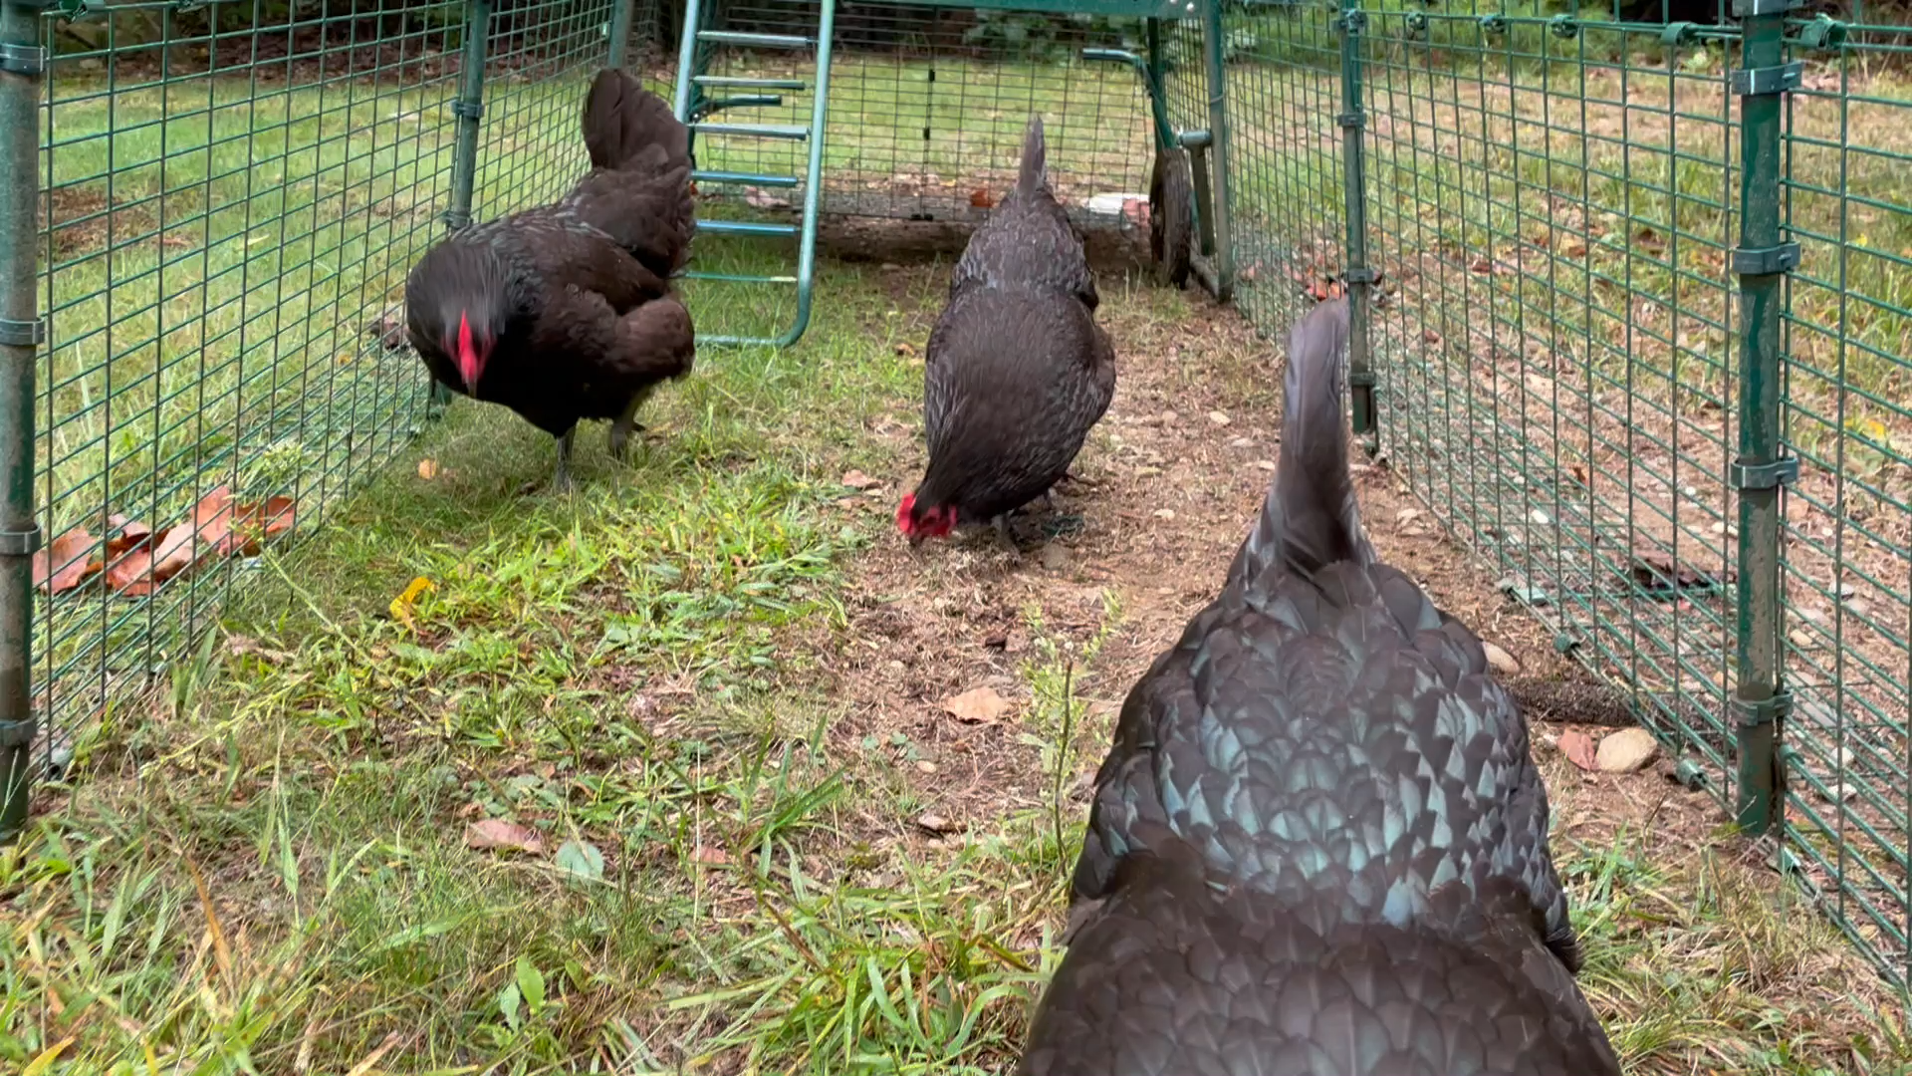
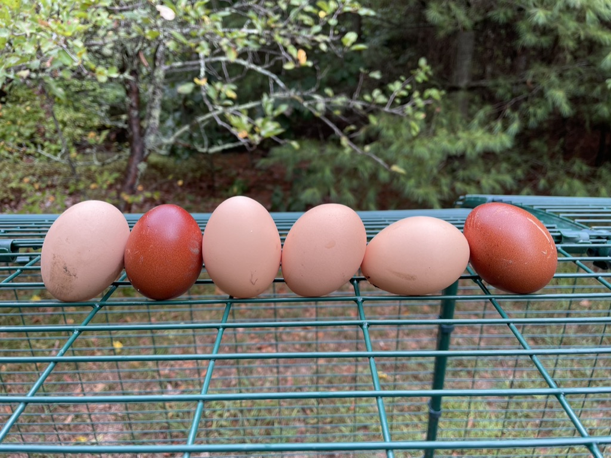
Which came first, the chicken or the egg?

Slide 3
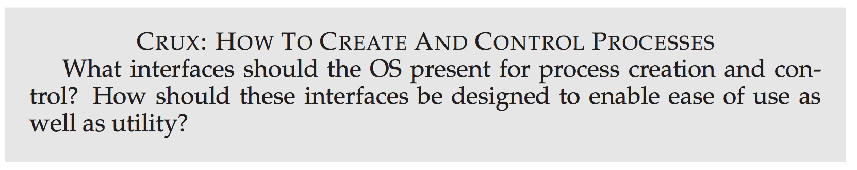

Slide 4
Creating New Processes
UNIX presents one of the most intriguing ways to create new processes
fork(): create a new child process
exec(): replace the “image” of a process with another

Slide 5
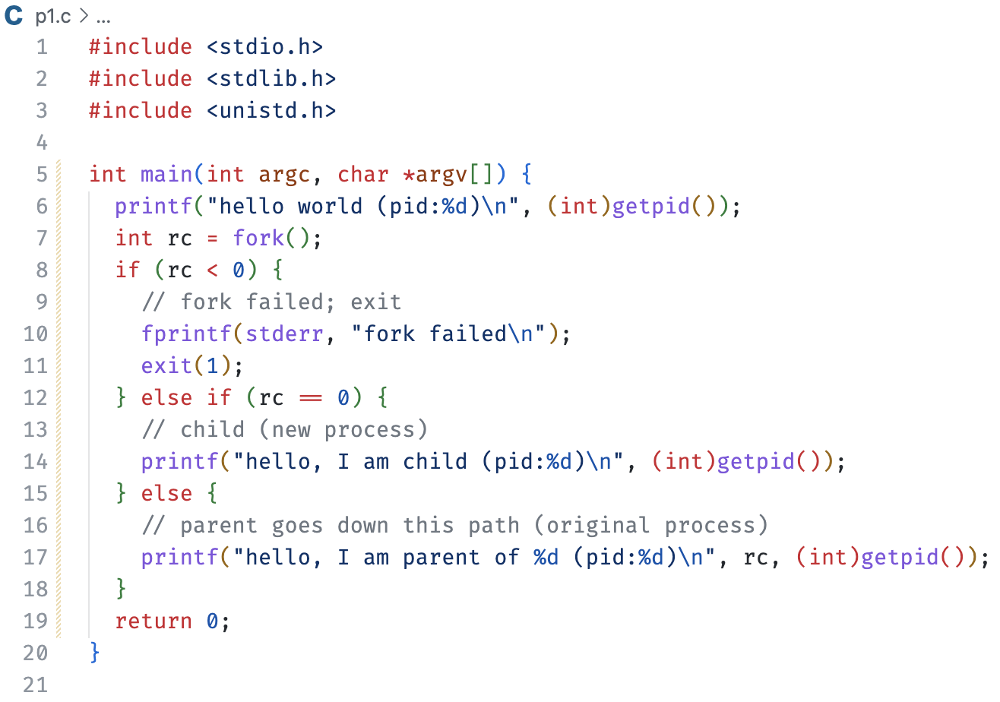
Here is an example program using fork.
When you run this program, you will see something like this…

Slide 6
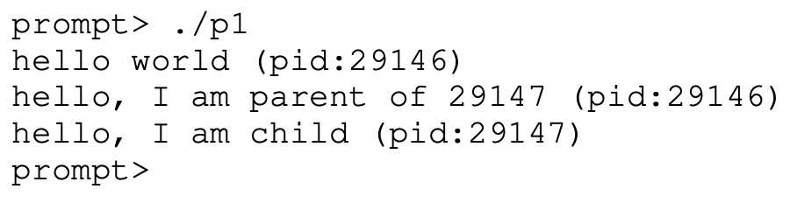
Here is an example program using fork.
When you run this program, you will see something like this…

Slide 7
First, we include a bunch of header files.
Aside, how do we know which header file to include anyway?

Slide 8
First, we include a bunch of header files.
Aside, how do we know which header file to include anyway?

Slide 9
First, we include a bunch of header files.
Aside, how do we know which header file to include anyway?

Slide 10
First, we include a bunch of header files.
Aside, how do we know which header file to include anyway?

Slide 11
The entry point for the process that we starts when we run a program from the command line.
p1

Slide 12
Here, we print the process id (pid) of the currently executing process.
p1

Slide 13
A call to fork.
Invokes code in the OS to create a new process (PCB).
It creates a child.
p1
p1

Slide 14
Execution continues in both the parent and child process from the point of return from fork.
p1
p1

Slide 15
It is non-deterministic as to which process will “have” the CPU next.
p1
p1

Slide 16
Let us assume the parent continues to execute.
It checks the return value – always a good thing to do.
p1
p1

Slide 17
We check the return code.
A non-zero value indicates that it is the parent.
It is the PID of the child.
p1
p1

Slide 18
At this point, there is a context switch.
Why?
p1
p1

Slide 19
The child starts to execute.
It checks the return value, but it never fails in the child.
We just won’t reach this point.
p1
p1

Slide 20
We check the return code. If it is 0, which in this case it is, we are executing in the child process.
p1
p1

Slide 21
Right before we make the call to printf, there is a context switch.
Why?
p1
p1

Slide 22
The parent invokes printf.
p1
p1

Slide 23
The parent returns from main.
This puts the parent process into a waiting status for the child automatically.
p1
p1

Slide 24
The child resumes execution at some point.
READY -> RUNNING
p1
p1

Slide 25
Calls printf.
p1
p1

Slide 26

Returns from main.
This creates a zombie process.
p1
p1

Slide 27
The parent process has already completed executing, so the OS is going to reap the child.
p1
p1

Slide 28
The parent process has already completed executing, so the OS is going to reap the child.
p1

Slide 29
Although the parent has exited, it will not necessarily automatically be deallocated.
Why?
p1

Slide 30
The shell will handle the reaping of the parent.
Unless it wasn’t the shell that created it…
shell
p1

Slide 31
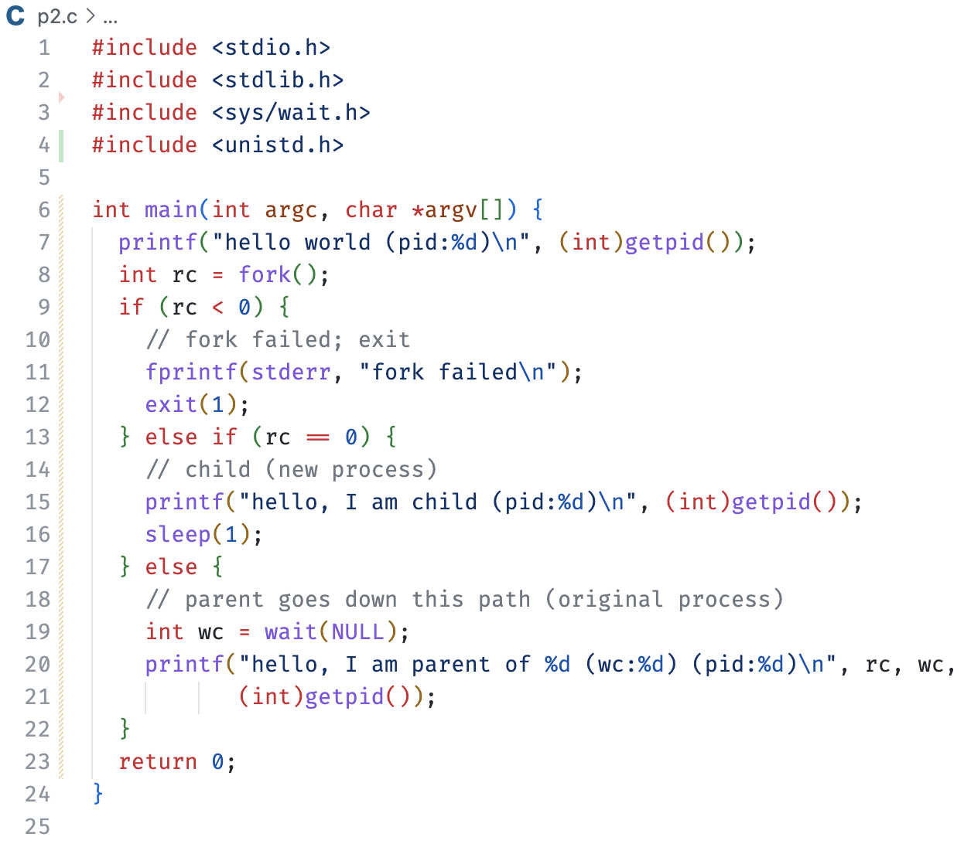
Here is a slight variant to the previous program.

Slide 32
We begin execution in main.
p1

Slide 33
We print.
Then call fork.
Creates a child.
p1
p1

Slide 34
We check for errors.
p1
p1

Slide 35
We check if we are the child.
We are not.
p1
p1

Slide 36
We call wait.
This will cause the parent process to “sleep”.
Waiting for the child to complete.
p1
p1

Slide 37
We context switch to the child (at some point later in time).
p1
p1

Slide 38
We return from fork and check return codes.
If we get to this point, there is no error in the child.
p1
p1

Slide 39
We are running the child process, so our return value from fork is 0.
p1
p1

Slide 40
We print.
p1
p1

Slide 41
We print.
p1
p1

Slide 42
Next, we put the process to sleep for 1 second.
This will allow other processes to execute.
But not the parent.
Why?
p1
p1

Slide 43
We return from sleep.
Then return from main.
We now have a zombie child.
p1
p1

Slide 44
Eventually, the parent executes again.
We return from wait since the parent has a child that has exited.
This kills the zombie.
p1
p1

Slide 45
The parent prints.
p1

Slide 46
The parent prints.
And finally returns from main.
p1

Slide 47
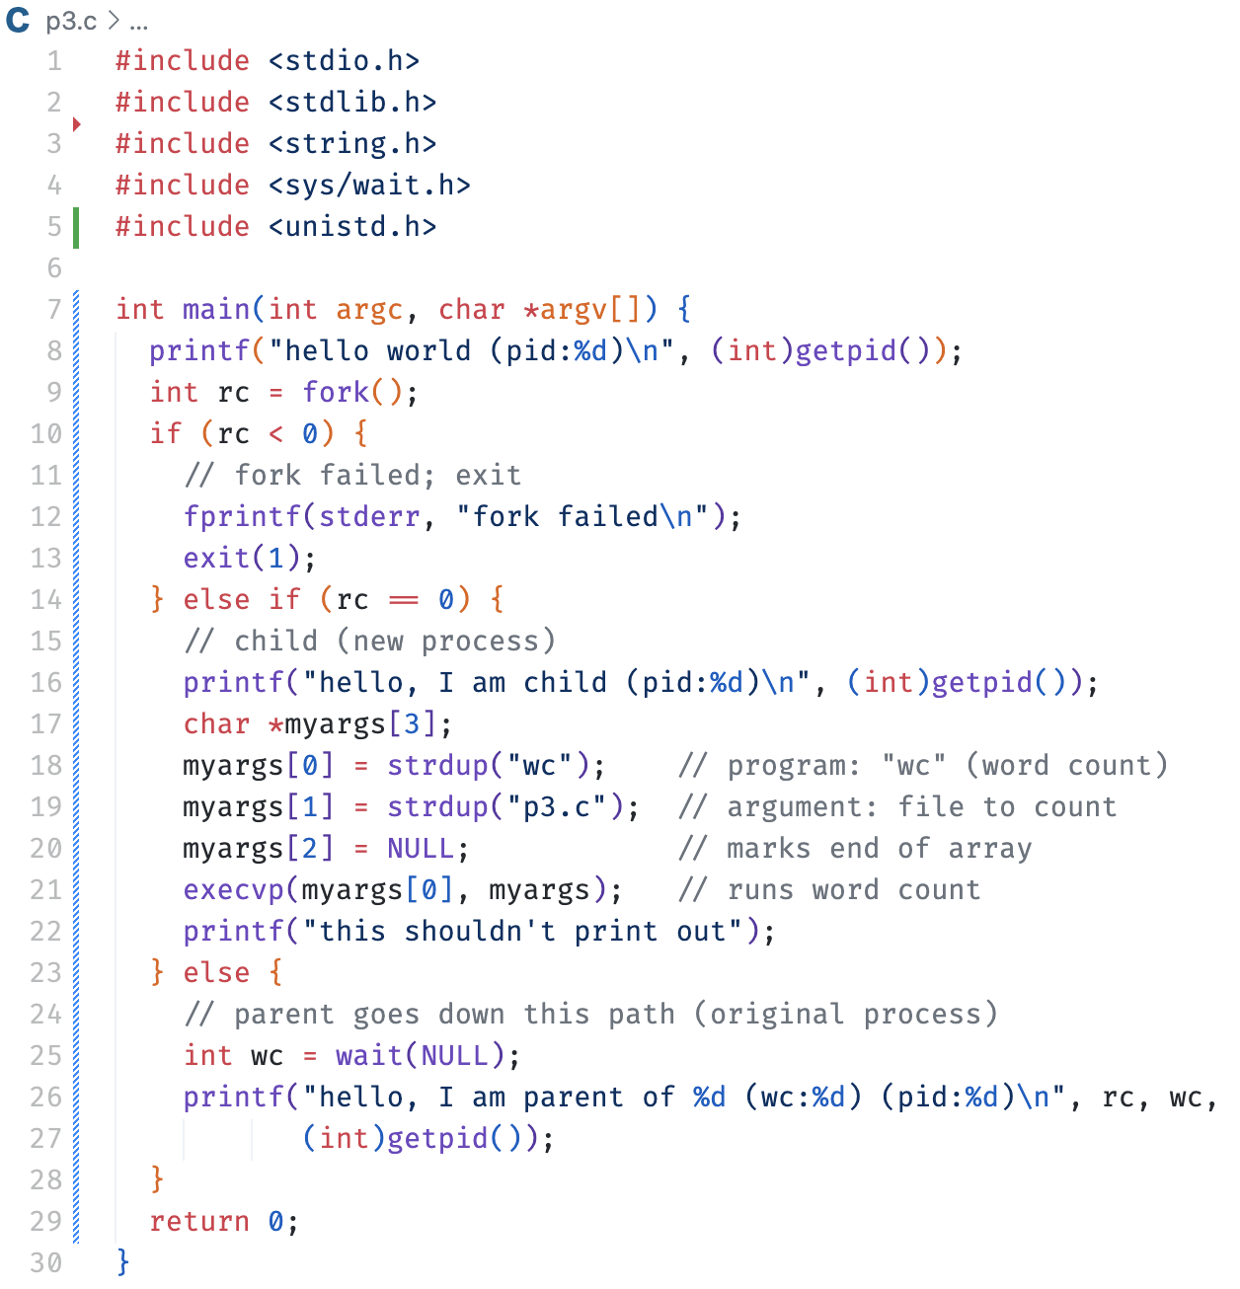
Now, let’s do something cool.
We once again start in main.
p1

Slide 48
The parent process prints.
It then calls fork.
p1
p1

Slide 49
Imagine we context switch to the child.
p1
p1

Slide 50
We print.
p1
p1

Slide 51
Next, we create an array of pointers to characters (aka strings).
We duplicate string literals and assign them to particular positions in the array.
p1
p1

Slide 52
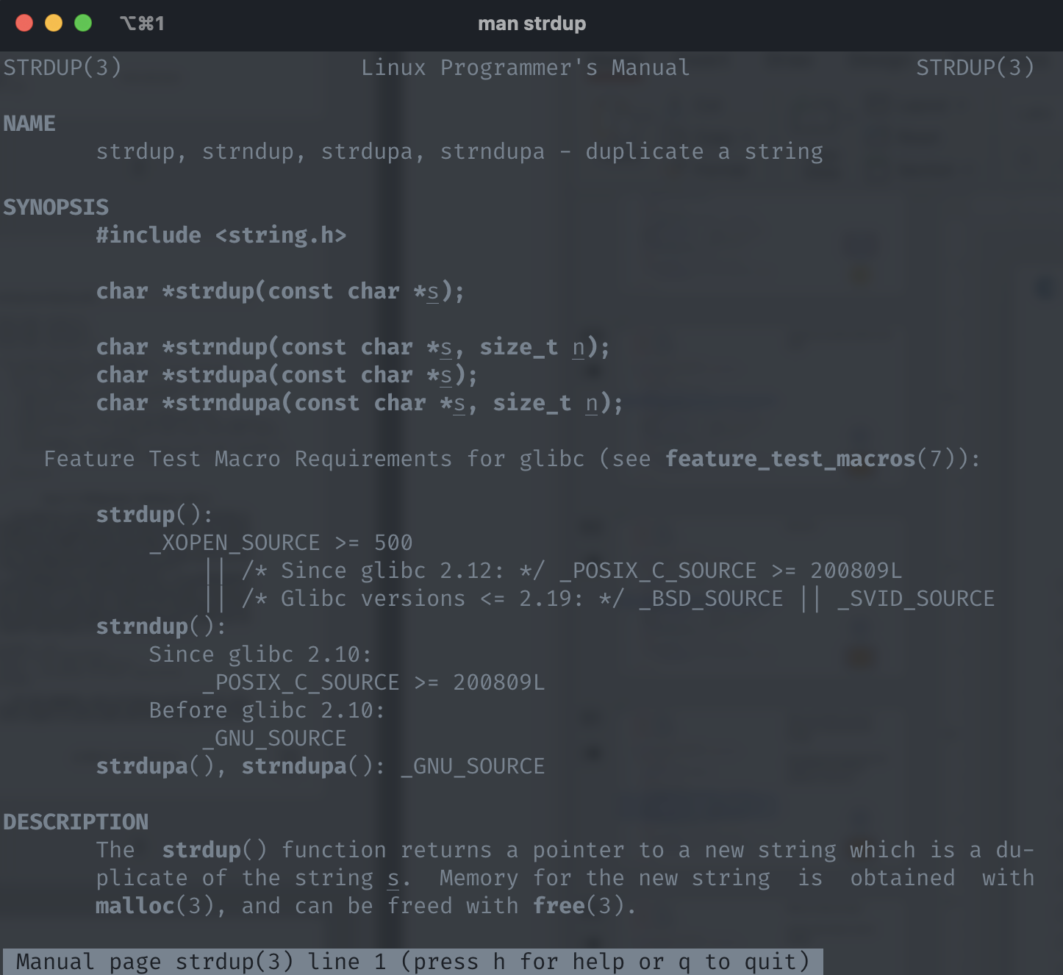
What are these strings?
And for that matter, what is strdup?
p1
p1

Slide 53
What are these strings?
These strings are the program we want to execute in place of the currently executing process.
wc: the “word count” program
p3.c: the argument to wc
NULL: the end of the args
p1
p1

Slide 54
We are just about to execute the next line in the child, but we have a context switch.
p1
p1

Slide 55
This process is not the child, so we continue.
p1
p1

Slide 56
We call wait and, well, wait.
We then context switch back to the child.
p1
p1

Slide 57
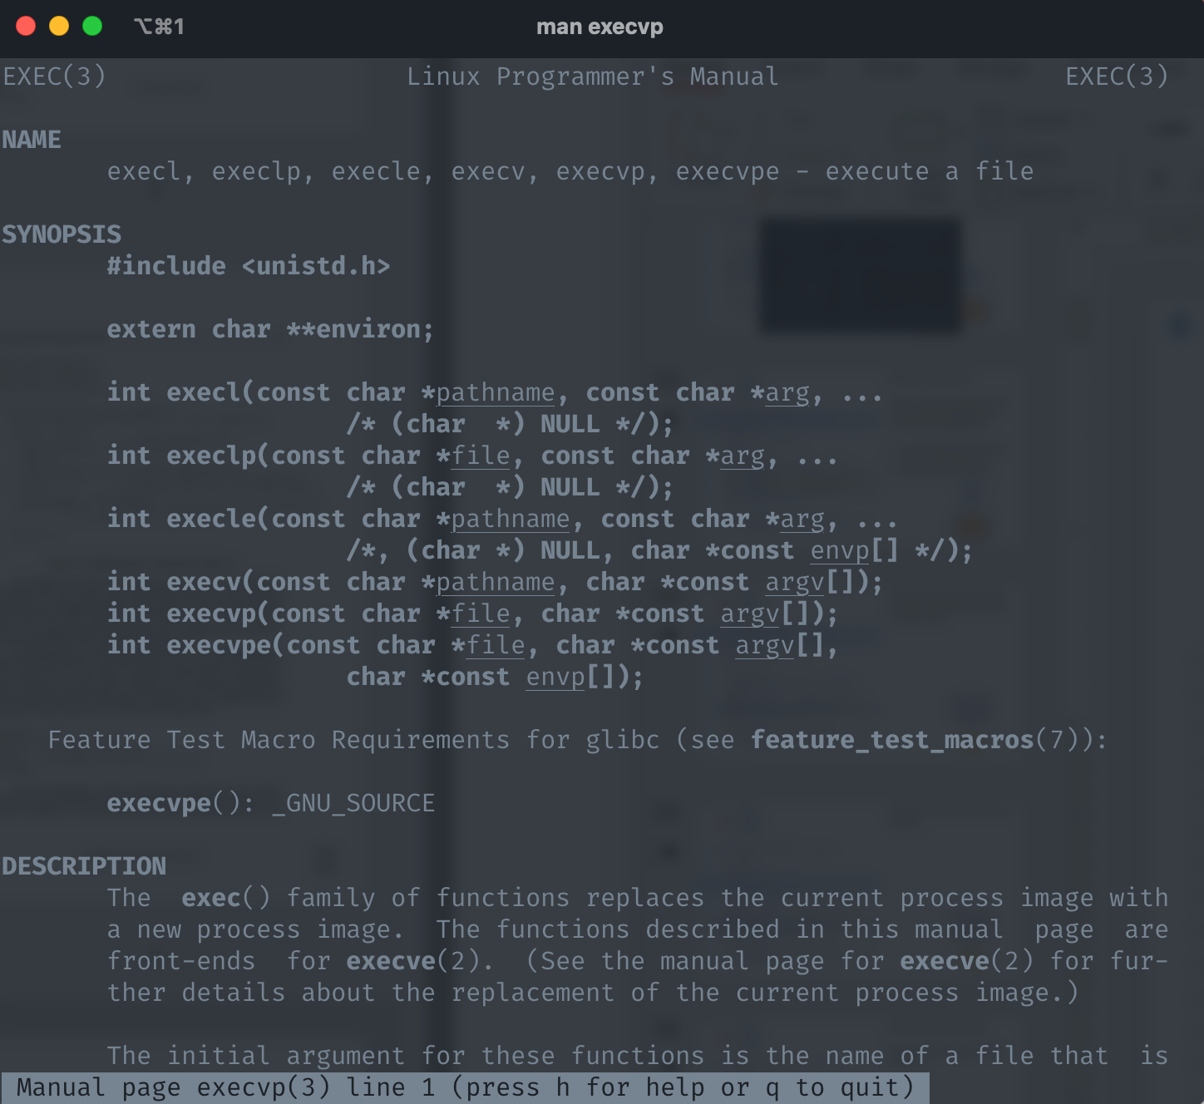
The child process calls the execvp system call passing it the string contained in the first array location and a pointer to the start of the array in the first and second parameters, respectively.
What is execvp?
p1
p1

Slide 58
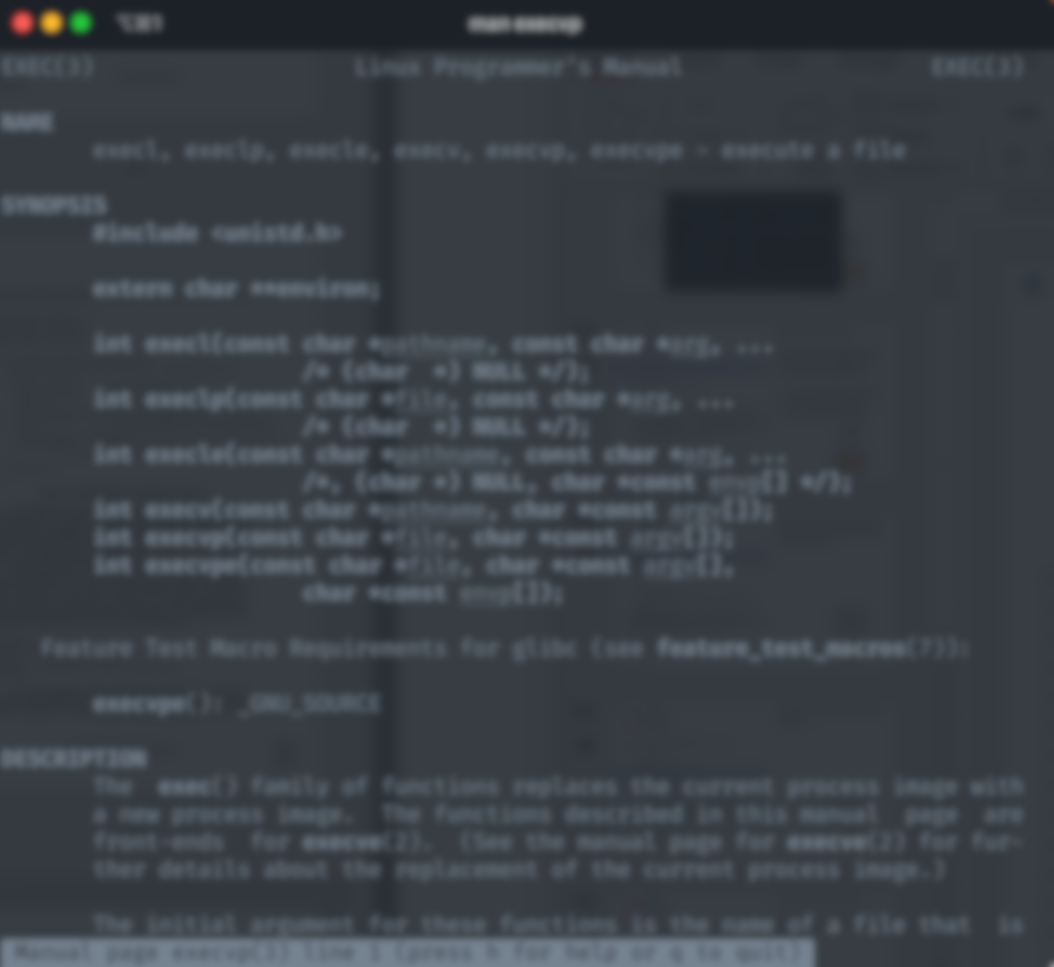
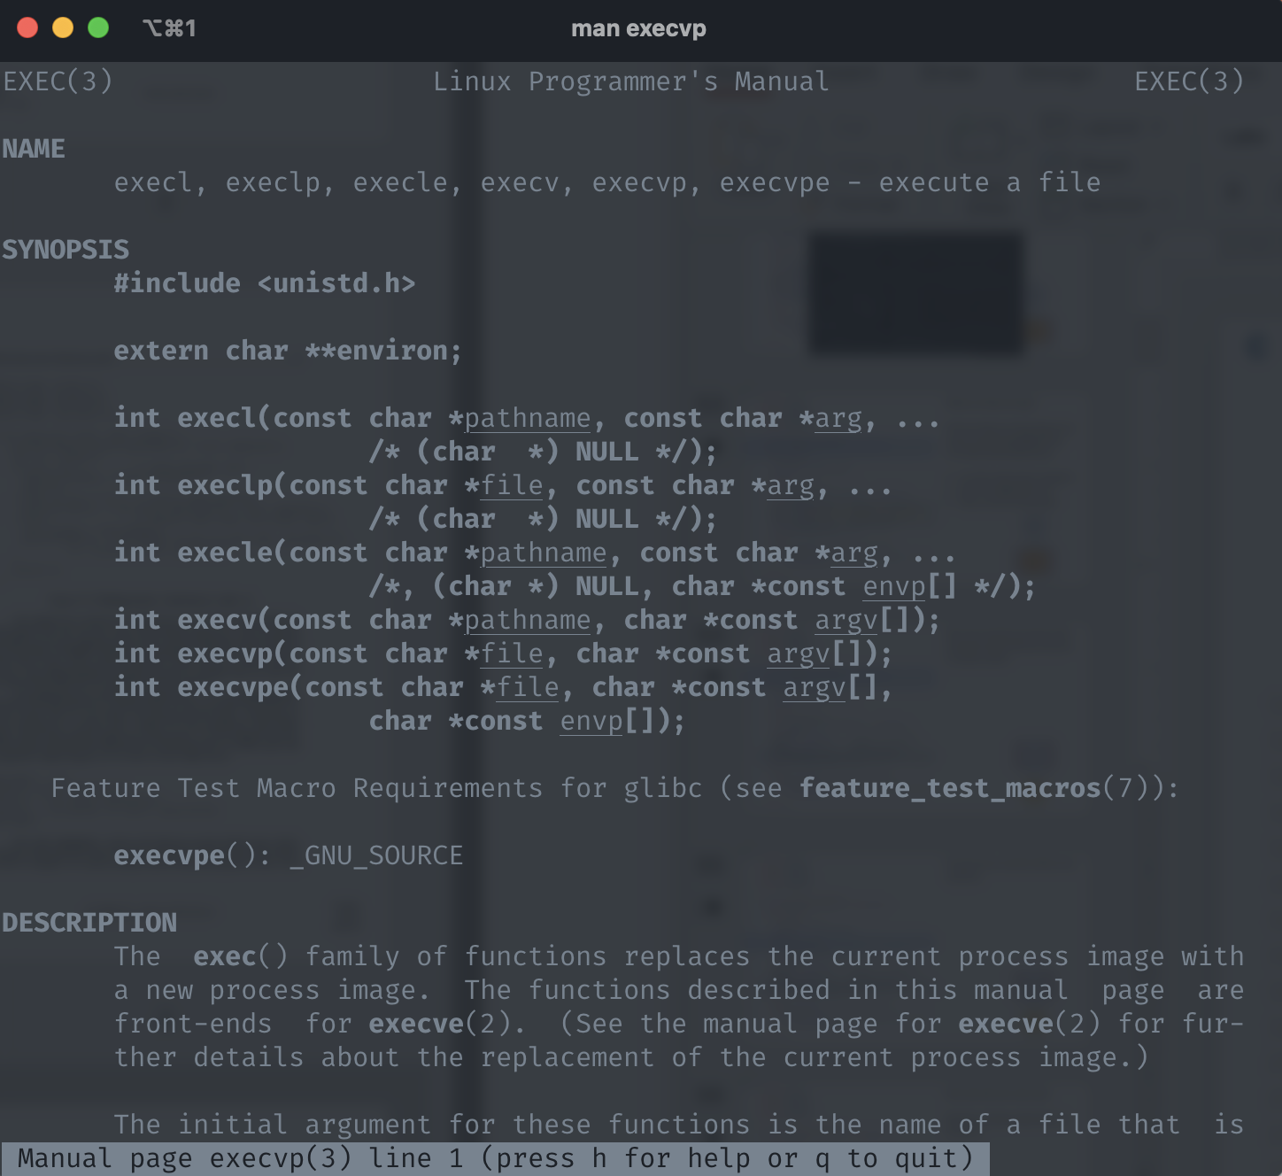
The child process calls the execvp system call passing it the string contained in the first array location and a pointer to the start of the array in the first and second parameters, respectively.
p1
p1

Slide 59
execvp is going to replace the current process image with a new process image.
The image of the wc program.
p1
wc
p1

Slide 60
At this point, the child process has a new face and begins execution from main in the wc program.
It ceased to be the process you know of as the p1 program…
It has been replaced by the formidable wc program.
p1
wc

Slide 61
The execvp system call never returns.
Unless, of course there is an error.
p1
wc

Slide 62
At some point in the future, we context switch back to the parent.
We assume the wc program runs to completion and eventually exits.
p1
wc

Slide 63
The wait returns.
Eventually, the parent returns.
p1

Slide 64
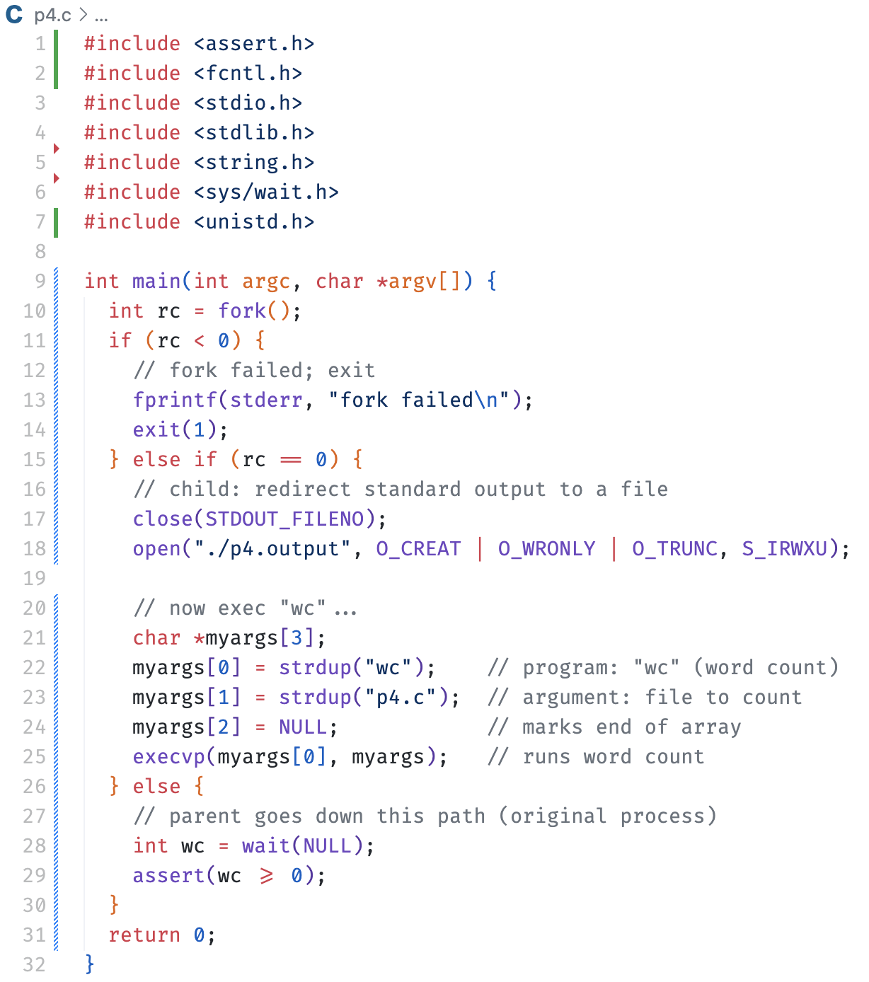

Ok, last example. Phew!
This is very much like the last example, but with a twist!

Slide 65
Let’s fast forward to this point in time.
The parent is waiting.
The child is executing.
p1
p1

Slide 66
In this example, it is important to mention that all processes are associated with the standard I/O streams: stdin, stdout, stderr.
stdin
p1
stdout
stderr
stdin
p1
stdout
stderr

Slide 67
The child then closes the standard output stream.
Yes, you can do this.
And for good reason.
stdin
p1
stdout
stderr
stdin
p1
stdout
stderr

Slide 68
The child then opens a new file “./p4.output”.
This new file will be assigned the standard output file descriptor effectively making it the new standard output.
How?
stdin
p1
stdout
stderr
p4.output
stdin
p1
stdout
stderr

Slide 69
When execvp is called, the file descriptors are passed on to the new process image.
Thus, all standard output is redirected to the file.
This is how shells implement I/O redirection.
stdin
p1
stdout
stderr
p4.output
stdin
p1
stdout
stderr

Slide 70
Why? Motivating the API
Of course, one big question you might have:
Why would we build such an odd interface to what should be the simple act of creating a new process?

Slide 71
Why? Motivating the API
Of course, one big question you might have:
Why would we build such an odd interface to what should be the simple act of creating a new process?
Well, as it turns out, the separation of fork() and exec() is essential in building a UNIX shell.

Slide 72
Why? Motivating the API
Of course, one big question you might have:
Why would we build such an odd interface to what should be the simple act of creating a new process?
Well, as it turns out, the separation of fork() and exec() is essential in building a UNIX shell.
It lets the shell run code after the call to fork() but before the call to exec() this code can alter the environment of the about-to-be-run program, and thus enables a variety of interesting features to be readily built.
Notes:
Run sleep 1000
Then in another shell run pstree (have to install via brew etc.). This show the process tree.
On a mac the root process is launchd and everything is fork execed from there.
Running htop is a good example as well.

Slide 73

The End

